Slide 1
Activities from June 2025 to June 2026
Zenabu Suboi
Cohort implementation in OM (with Christian)
Teaching at Summer school in Kenya
Simulation set-up, running and analysis of results
Update of ITN parameterization
Rerunning simulation and analysis of results
Final course work
Presentation of results to CHAI
Second Annual PhD Committee Meeting
Manuscript writing

Slide 2
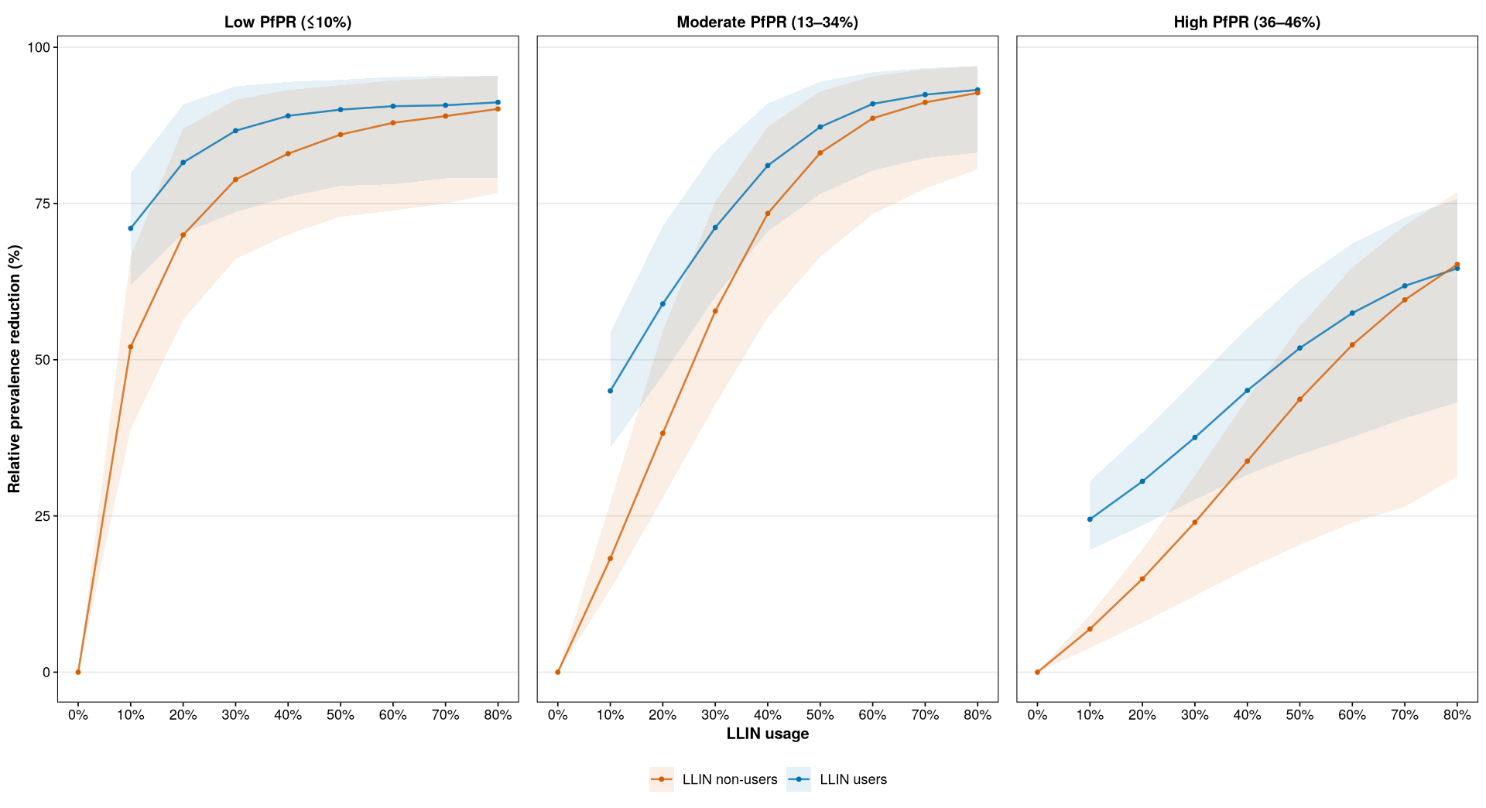
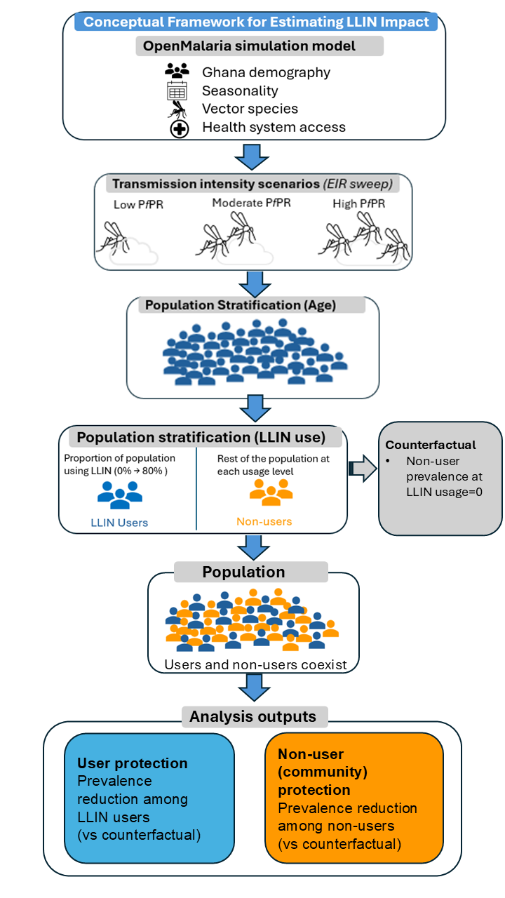
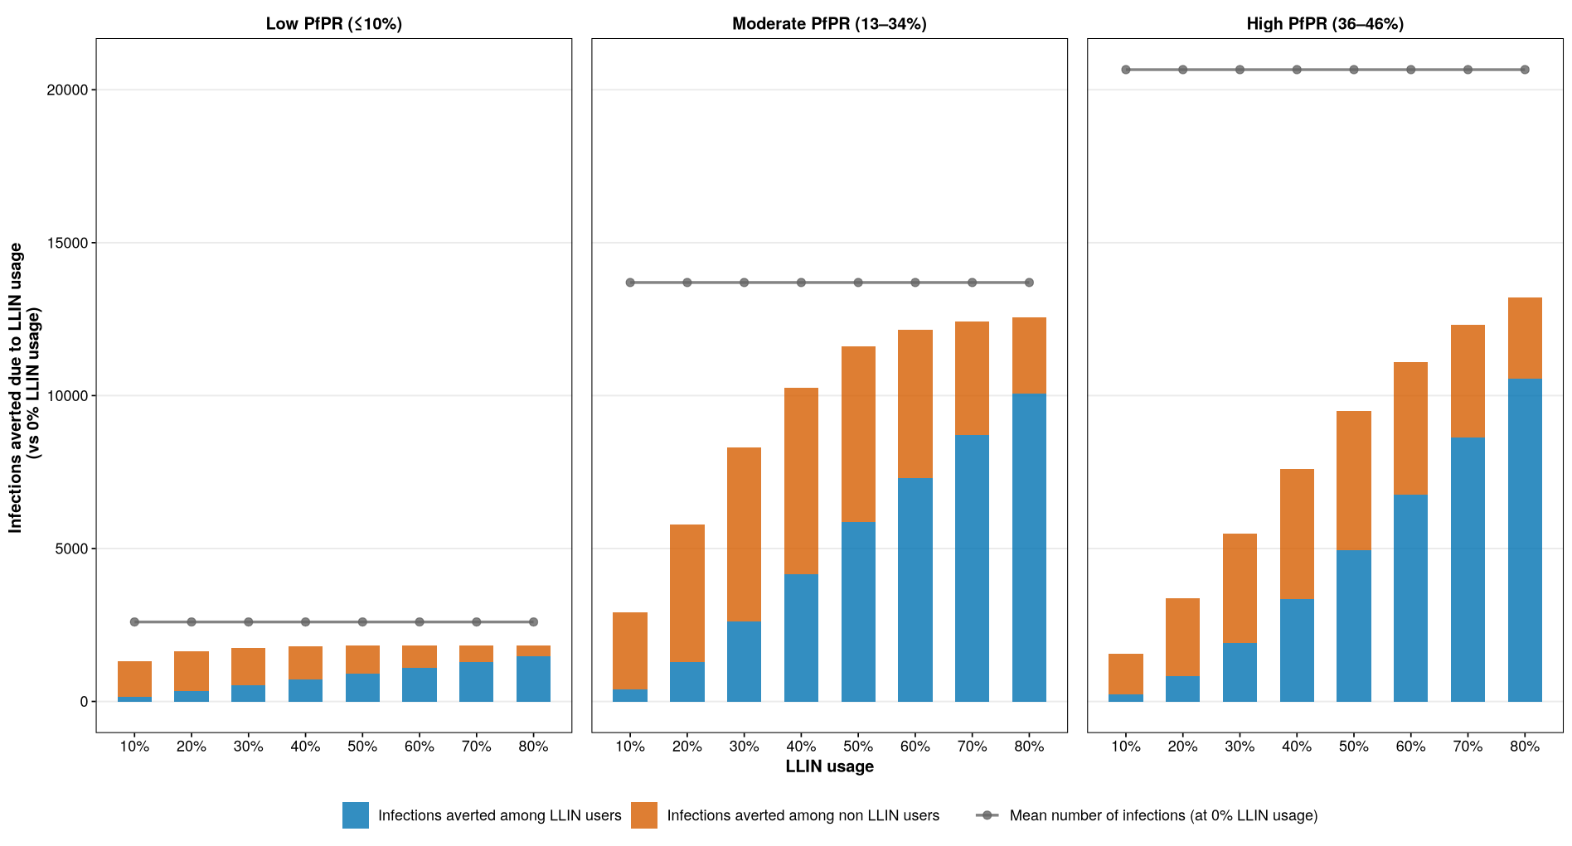
Evaluating the Community Effects of LLINs across Transmission Intensities
Zenabu Suboi
1. Question
How does the protection offered by LLINs vary among LLIN users and non-users across transmission intensities and effective usage levels?
2. What did I find?
3. How did I go about it?
4. Challenges
Cohort implementation in OpenMalaria
Transitioning to the new ITN parameterization
Finding the right figures to better communicate the message
5. Conclusion
Community protection is stronger and plateaus in low and moderate, but not in high transmission settings
Results suggest no need for high coverage in low transmission
LLINs should be complimented with other malaria control interventions, especially in high transmission
Notes:
To correctly print, use the "create and share Adobe PDF" function on the "home" tab of PowerPoint - it will not correctly print if you use the normal print function.

